Slide 1


Automobile Maintenance App
By Team 2
Aliza Levinger
Tianyu Li
Brenden O’Reilly

Slide 2
Pitch
Team 2 would like to create an Android mobile app to help people keep their automobiles in good working order. We would like to call this app the Automobile Maintenance App.
The link for our Wiki is:
https://github.com/paceuniversity/cs6392015team2/wiki

Slide 3
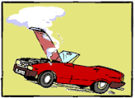
The Problem
Too many people don’t regularly have their cars serviced.
They spend too much on repairs.
They don’t keep accurate records of their car’s service records.

Slide 4

Do Americans Love Their Automobiles?
Let’s find out.

Slide 5

Passenger Vehicles in the U.S.
More passenger vehicle than any other country.
354 million passenger vehicle.
More than one automobile for each person able to drive
Growing steadily since 1960.

Slide 6






New Cars Sold Each Year
12.8 million new cars sold in the U.S. in 2011, with an average price of $30,300.

Slide 7

U.S. Automotive Aftermarket
Estimated to be worth 318 billion.
Contributes 2.3 % of GDP
Employs 4.2 million people.

Slide 8

Auto Repair Shops
Almost 160,000 automobile repair shops employing 650,000 people, according to Auto Shop Online.
Average auto repair bill on the rise

Slide 9
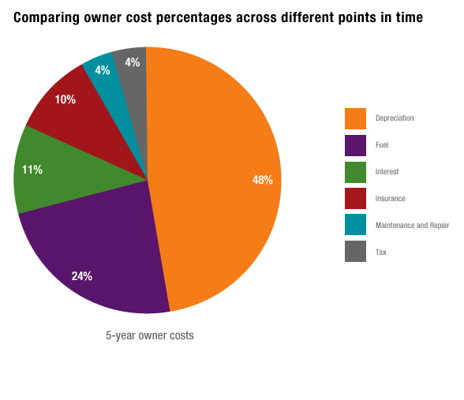
But Cars Are Expensive

Slide 10

App Demographic
Huge Demographic
Basically anyone that wished to keep their automobile in good working order, and wishes to save money on repair bills.

Slide 11

Typical User
Mike is a hypothetical car owner. He is proud of this 2010 Chevy Comaro and wants to keep it in perfect running order. He would also like to save as much as possible on his auto repair bills.

Slide 12

Competitors
aCar
Car Maintenance Reminder Lite
CarPros – Car Management
Carango – Car Management
Vehi Car – Car Maintenance

Slide 13

How Our App is Better
There are several apps in the Pay Store that provide similar features. Automobile Maintenance App will provide many of the features of these competitor apps with a better user interface.

Slide 14

Technology
Android Studio
Android SDK
ListViews
Default Android Phone Dialer
AsyncTask

Slide 15
Features
Register your vehicle information, as well as its image.
Track vehicle maintenance.
Setup reminders for upcoming suggested service appointments.
Quick dialing feature to his mechanic, in case of emergencies.

Slide 16
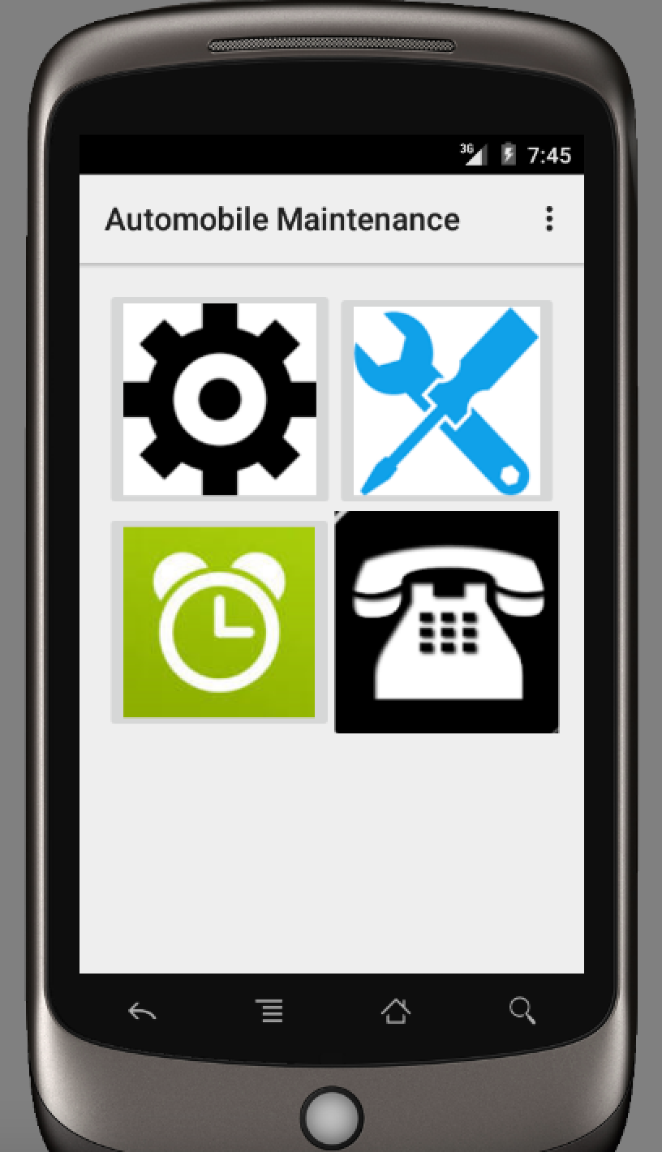
The Main Activity

Slide 17
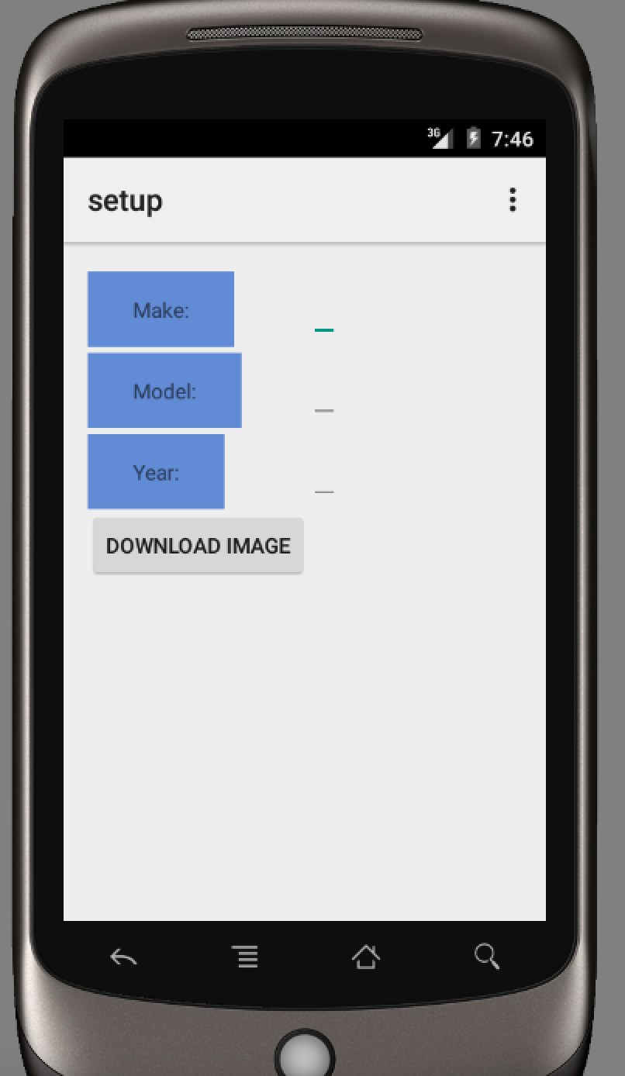
Setting Up Your Automobile

Slide 18
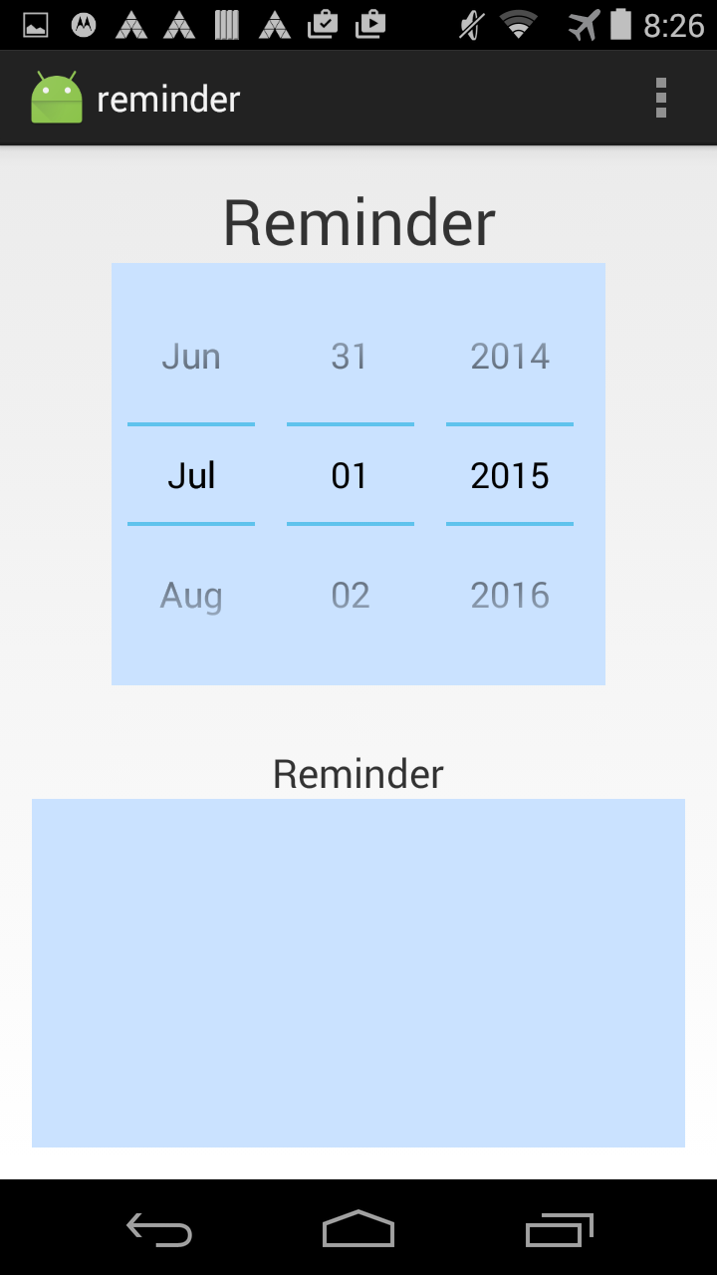
Adding Reminders

Slide 19
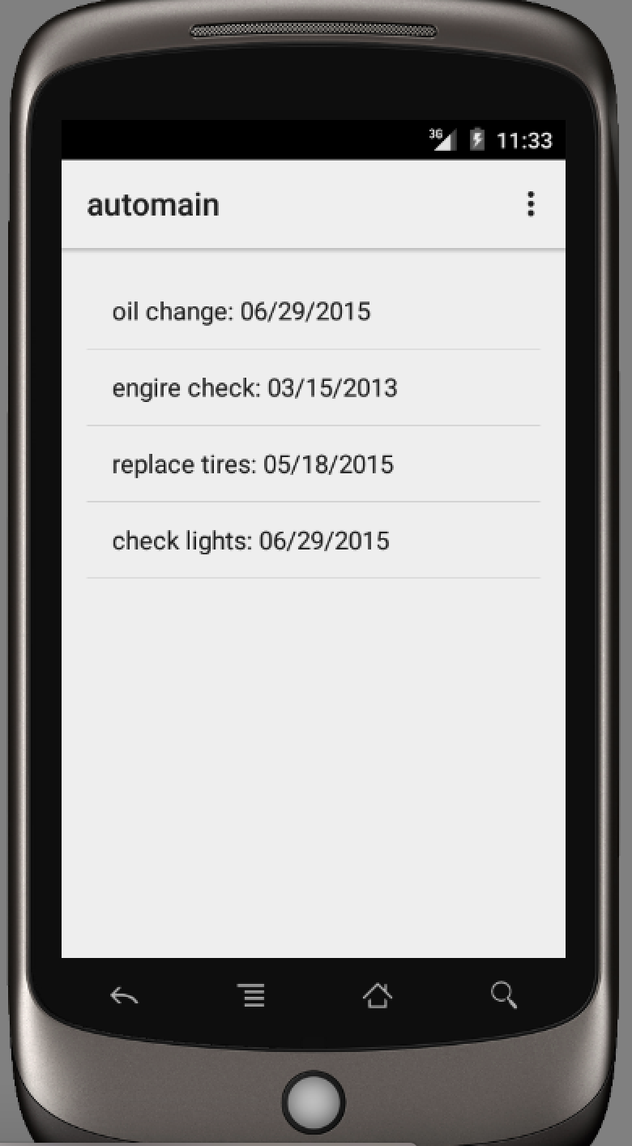
The Maintenance Log

Slide 20
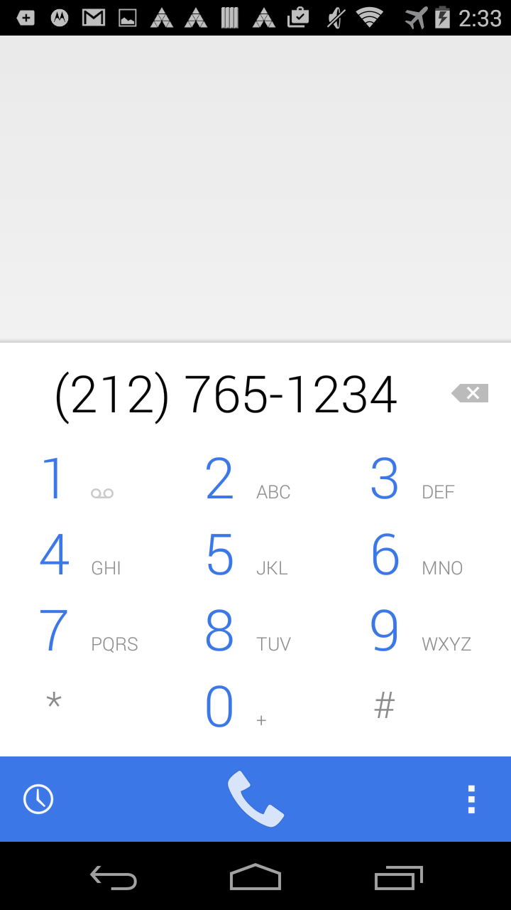
The Quick Dial Feature

Slide 21

Status of App
We have created a working prototype of our app with development scheduled to begin soon.

Slide 22

Challenges
Working within a team
Short time frame

